Slide 1
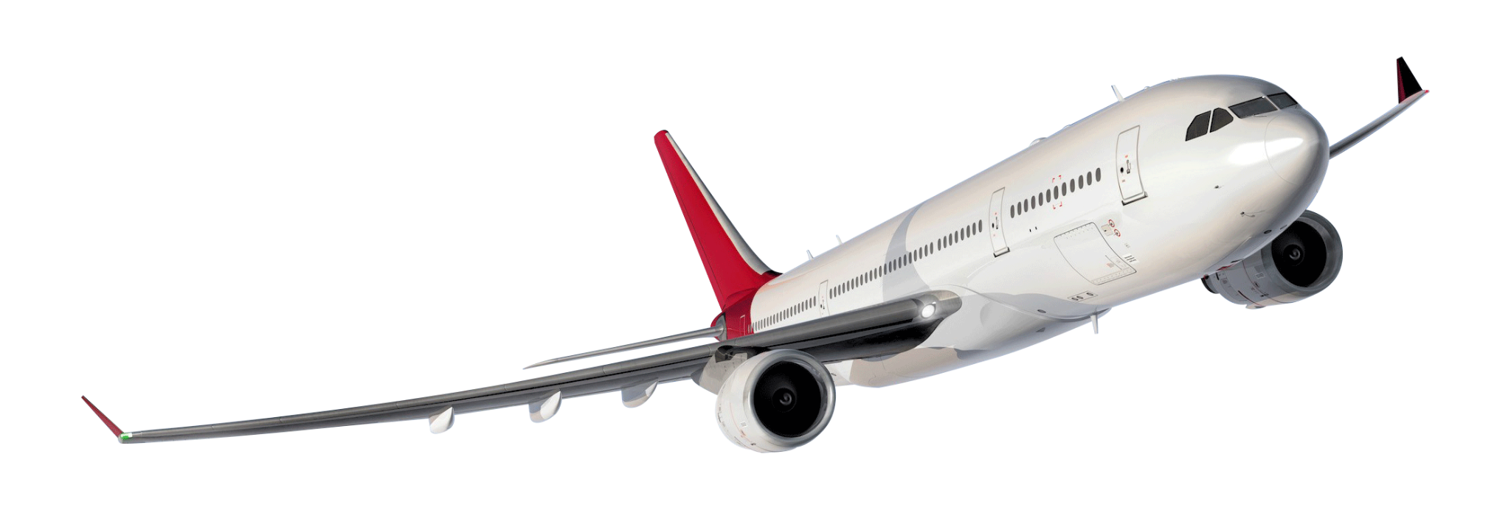
San Francisco Airport Data:
Pandemic Recovery Survey
Matthew Laken, N’Dea Jackson, Michael Armesto, David Doman

Slide 2
Data Description
Data Collection
Survey Questions
December 2020
San Francisco (SFO) airport conducts extensive research on customers that come through their facilities on topics such as satisfaction levels, preferences, and demographics throughout the course of the year. By collecting this data, the airport is able to refine their practices as well as strategically team up with partners to ensure that the San Francisco airport experience remains above satisfactory. Some decisions that are often impacted by this data include transit issues, concessions, and any other key areas of concern that arise from the survey.
Paper surveys handed out at San Francisco (SFO) airport
16 questions collecting information on traveler demographics and traveler comfortability
Participants
Objective
Identify groups of travelers that may need more encouragement before feeling safe flying and make recommendations to SFO to sway these customers
1,086 travelers participated in the survey

Slide 3
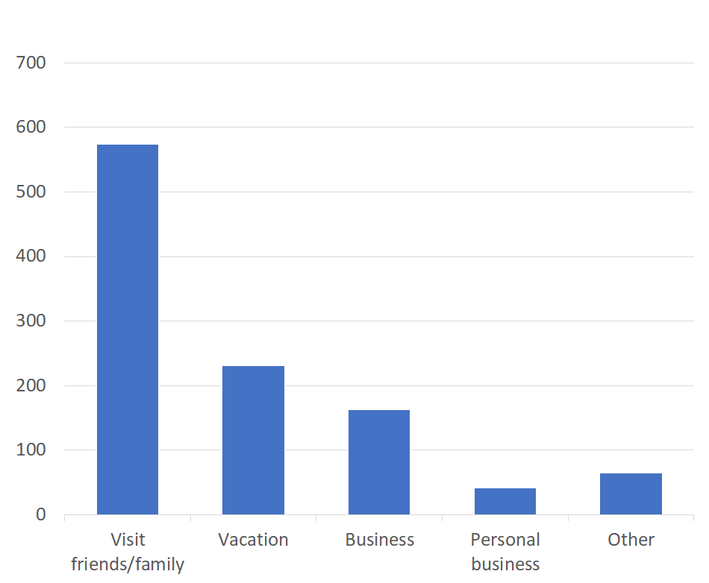
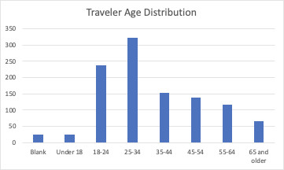
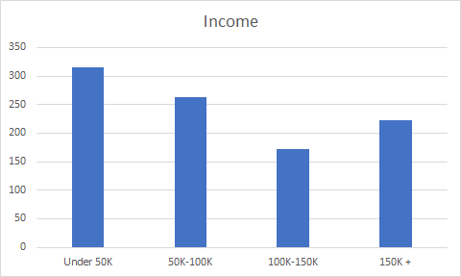
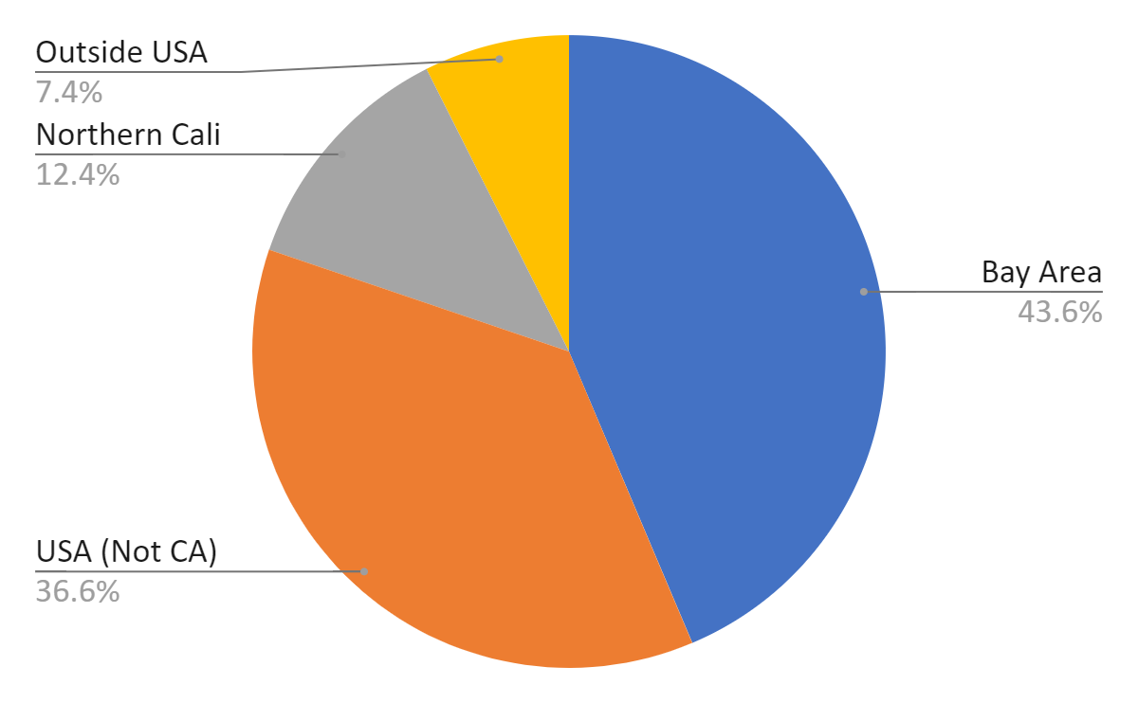
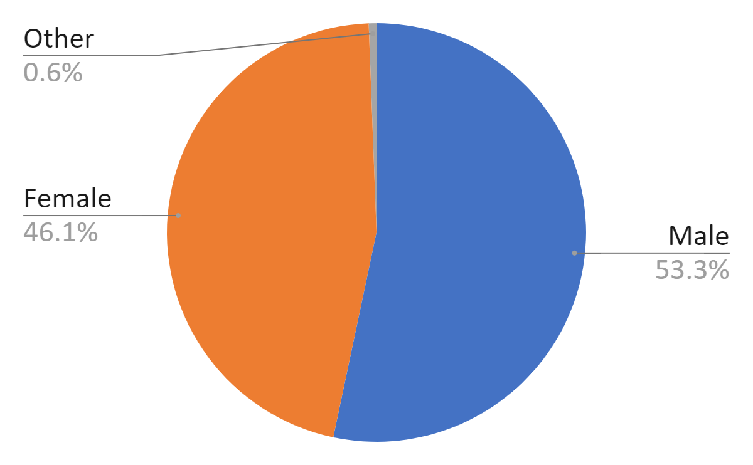
Exploratory Data Analysis
Reason For Travel
Travel Age Distribution
Residential Location
Gender
Income

Slide 4
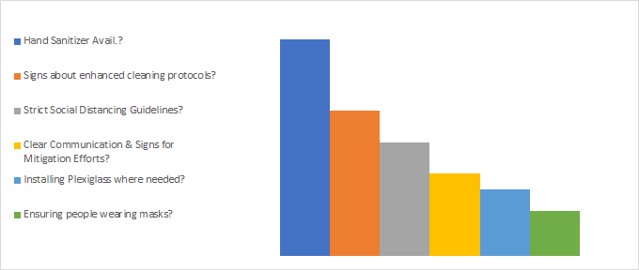
Traveler concerns about traveling
Most important factors for traveling:
- 47% of travelers selected strict social distancing guidelines and enforcement.
- 14% of travelers selected having hand sanitizer readily available.
- 11% of travelers selected ensuring everyone was wearing a mask.
Ranking of Travelers Needs
Hand Sanitizer Avail.
Cleaning Protocol Signs
Social Distancing Guidelines
Clear Communication
Installing Plexiglass
Ensure Mask Wearing

Slide 5
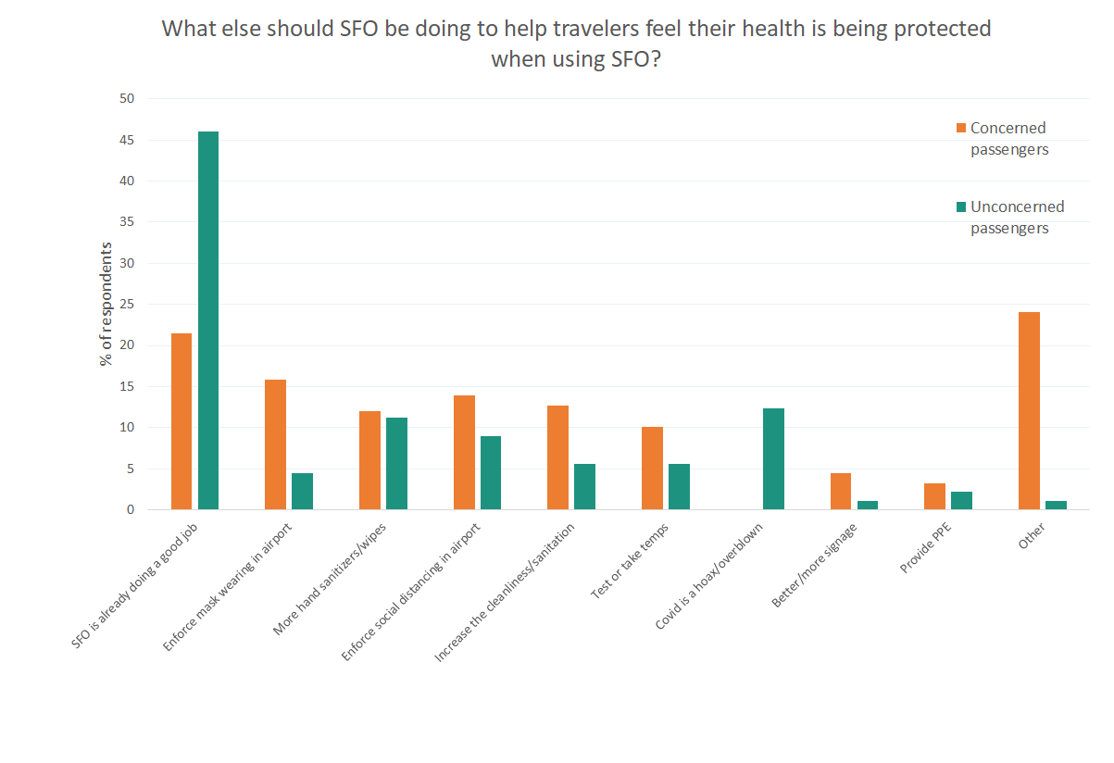
Notes:
Concerned passengers: 4 or 5 out of 5 for concern level
Unconcerned passengers: 1 or 2

Slide 6
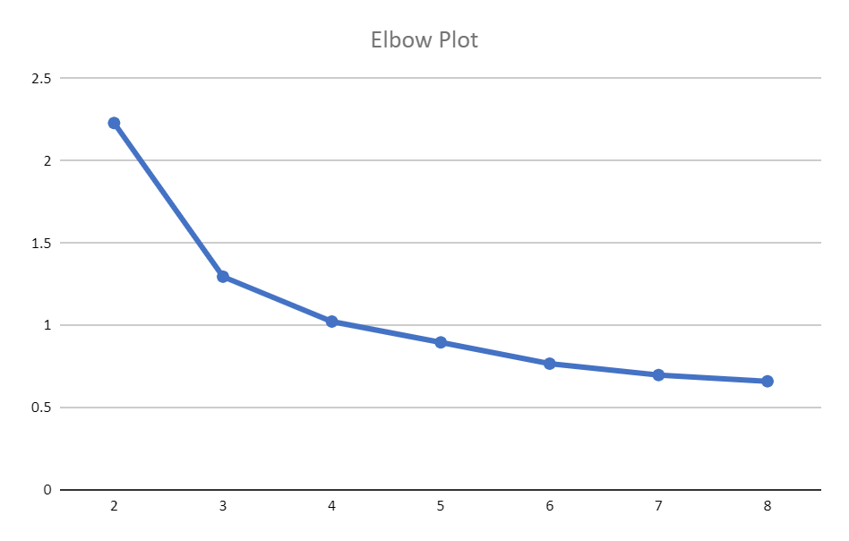

Elbow Plot: Determining the number of clusters
Elbow Plot
Plot begins to flatten out at around 3 or 4 clusters so this seems to be the amount of clusters to target
3 clusters was found to be the optimal amount
Notes:
Clustered with:
How concerned are you
Various rankings on current precautionary measures
Rating of current SFO response

Slide 7
Clustering Analysis Results and Survey Questions
Concerned Travelers (1)
Apprehensive
Travelers (2)
Confident Travelers (3)
These people tended to express more concern about traveling during the pandemic, and safety precautions.
These people expressed moderate concern about flying, but were the least satisfied about SFO’s current safety precautions
These people felt comfortable traveling during the pandemic, and expressed little concern about the airport’s current safety precautions.
Are “very concerned” about flying during the pandemic
Most likely to arrive at the airport by private transportation
Lowest average income of all three groups
More business travel than other groups
Oldest average age of all three groups
Gave SFO lowest rating on overall response to protect travelers
Lowest ratings on all questions about SFO’s current precautions
Lowest average age
Least likely to be traveling for business
Highest average income
Most vacation travelers
Highest average income
Most likely to arrive by public transportation
Highest rating on overall response to protect travelers precautions
Most likely in indicate “Covid is a hoax/overblown”
Most likely to want mask removal for vaccinated travelers

Slide 8

Customers to Target
Which customers should SFO target?
“Very concerned about flying”
Low ratings on current airport policies
Older people
Less likely to use public transport
Traveling for vacation > business
Which clusters? Why?
By targeting the “Concerned” Cluster, we hope to alleviate the tensions associated with resuming travel post pandemic.
We hope to capture the “Apprehensive” Cluster by taking extra precautions to meet the needs of the most vulnerable groups of people.

Slide 9
8 Month Plan: Recommendations
Jan 21
Mar 21
May 21
Jul 21
Phase 1: Immediate
Phase 2: Assurance
Phase 3: Check-in
Phase 4: Adapt
Enforce mask policies and social distance guidelines.
Installing additional barriers for workers.
Readily accessible sanitation stations.
Transparency into process of sanitising planes and public areas.
Improved management of airport food services- enforce grab and go.
Issue another survey to understand current needs.
Adjust policies according to vaccinations (opening maskless vax sections).
Respond to survey questions by adjusting policy

Slide 10
Safe Travels!
We hope you enjoyed our presentation!

